Slide 1

DSBA 6211 – Group Presentation # 3 HHUSA –Client Services
Wednesday, August 5, 2020
Nityanand Kore, Sachin Varule, Mrunmayee Kulkarni, Eric Rwabuhihi, Soumyadip Mitra

Slide 2
Presentation Outline:
Overview – HHUSA
Overview – Project Scope
Dataset Description
Data ‘Cleaning’ overview – steps, iterations, considerations
Project Questions
Closing Notes

Slide 3
Overview – HHUSA
Hire Heroes USA is a non-profit organization that works with U.S. Military members, veterans and families to shift and succeed in civilian workplace
Services include- Client registration, Preparing resume, Convert military experience into civilian terms, effective job searching, networking, connecting with companies and many others
Result- 60 clients are hired each week
Scope – 500K unemployed veterans at any given point

Slide 4
Overview – Project Scope
Project focus is on Client Services– specifically job seeker activities
With past data:
Find relationship between different datasets such as when client created an account and when they got a job
Whether any demographic information is related with easy success in job
Whether clients completed survey or not
Which communication (email/text/phone) was more effective
Data included email history from email campaigns via. software tool

Slide 5
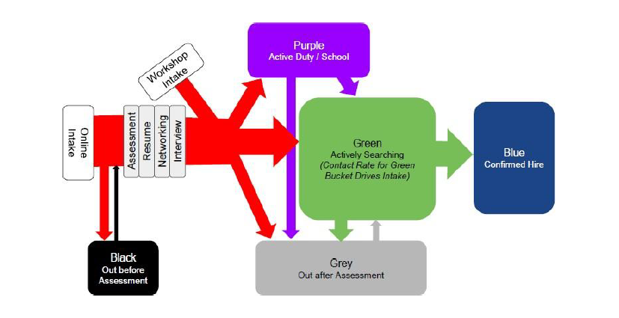
HHUSA – Client Process Flow

Slide 6
Dataset Description
Salesforce is used as HHUSA’s CRM. Data structured based on ‘Objects’ which Salesforce uses.
Salesforce based data included ‘.csv’ tables for:
Contacts
Hire Information
Activities
Feedback
Campaign
Accounts
Cases

Slide 7
Data Cleaning / Preparation
All the entities/data sets are identified to answer the questions.
Identifying relationship between various datasets i.e. primary keys, foreign keys and other reference data
Contacts – Hire Information
Contacts - Activities
Contacts - Feedback
Contacts – Accounts
Only required elements are extracted and cleaned new dataset with R.

Slide 8
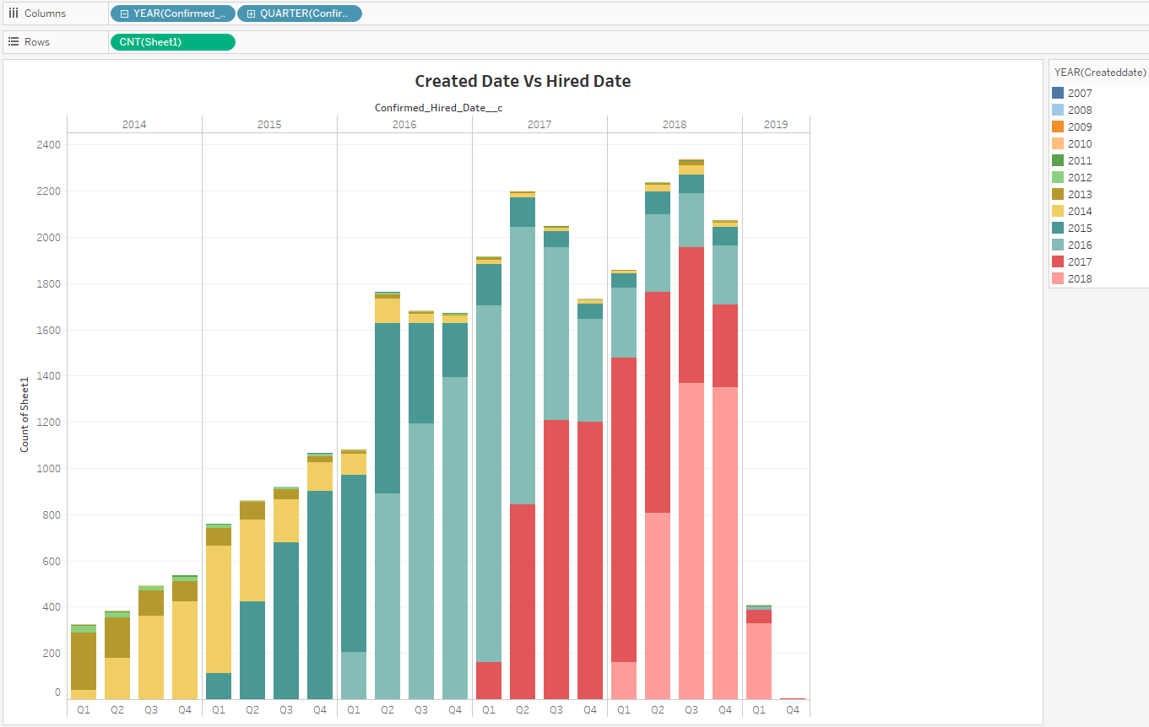
Initial Analysis of data
When account was created?
When hired by employer?
Did no. clients and hiring increase over time ?
How are these hiring tagged to campaigns ?
Do we have demographic data tied to hiring ?
How many emails were sent as part of each campaign ?

Slide 9
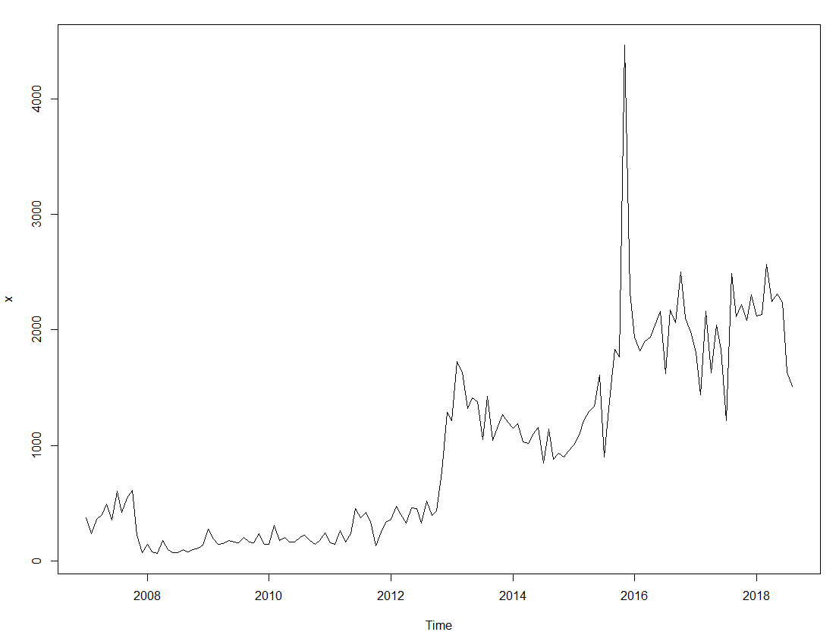
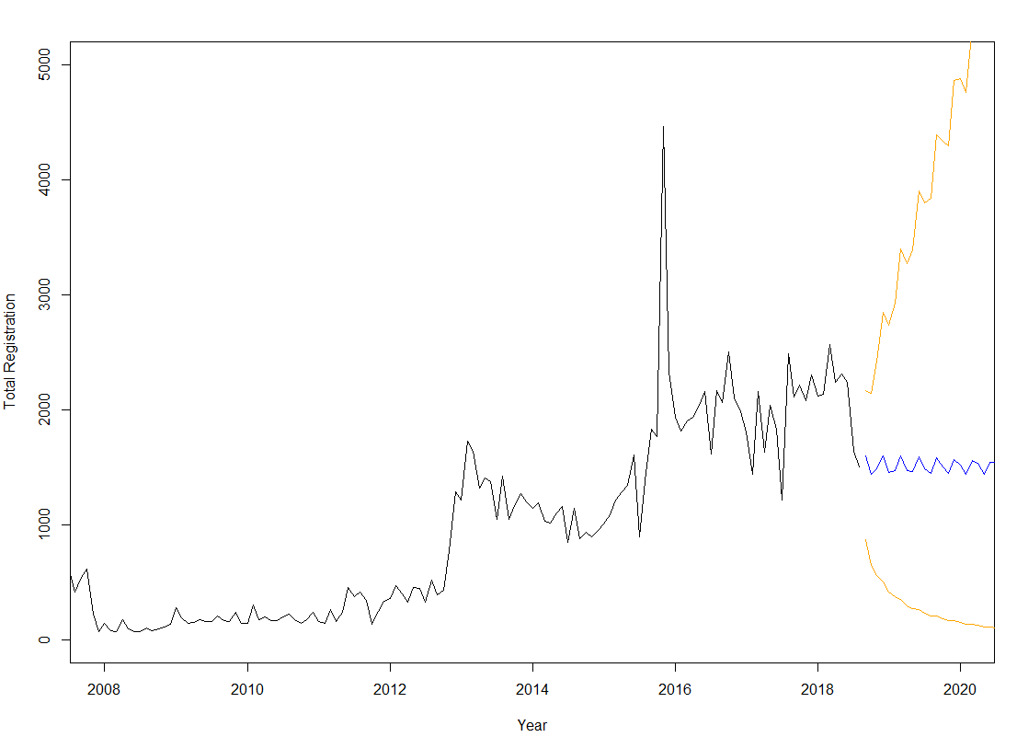
Q1. Client demographic and registration relation
Variables considered for this:
Service Branch
Service Rank
Gender
Race
Spouse Status
https://public.tableau.com/profile/nityanand.kore#!/vizhome/HHUSA-ClientServices/HHUSA-ClientRegistrationByDemographic
Notes:
Inferences:
Majority of the veterans from Army (51K) branch are registering followed by Navy (15K) and Marine and Air force (13K each).
Almost all branches veterans with Rank as E-4 are more interested in HHUSA services irrespective of their current job status (Active Duty, Employed, Unemployed etc.)
White Male and Female are highest percentage of people registering for HHUSA followed by Black African or American Male/Female.
Spouse registration also shows significant growth over the time as spouses are using services provided by HHUSA.

Slide 10
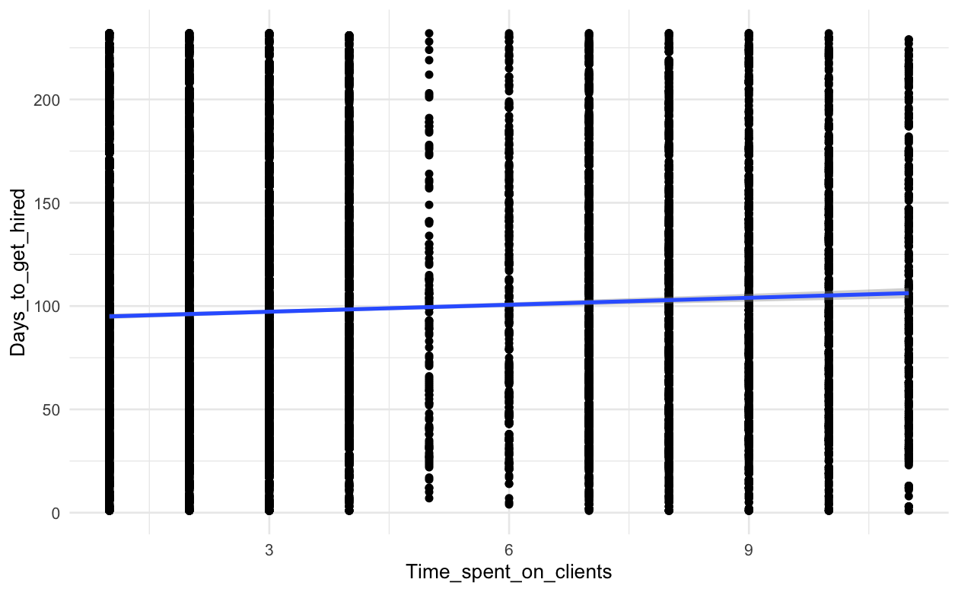
Q2. Relationship between Hired Vs time spent on client
Derived Variables
considered for this:
Days_to_get_hired = Date_Turned_Blue__c - Date_turned_green__c
Days_between_Assigned_and_Assessed = c_Dat_Initial_Assessment_was_Completed__c - c_Date_assigned_to_staff__c
Days_between_Assessment_and_Resume = c_Date_Resume_Completed__c - c_Dat_Initial_Assessment_was_Completed__c
Time_spent_on_clients = Days_between_Assigned_and_Assessed + Days_between_Assessment_and_Resume
Notes:
Inferences:
We are not seeing any relationship between the How quickly the candidate got hired and the time spent on them.
We see that for the same amount of time spent on candidates, different client get hired on different intervals
The linear regression line among them also look flat

Slide 11
Q3. Effective Communication Method
Variables considered for this:
Task Subtype
Race
Gender
Confirmed Hired Date
As per below Tableau Visualization it is clear that Email was the most effective communication Method
https://public.tableau.com/profile/nityanand.kore#!/vizhome/Q4_CommunicationMethods/HHUSA-EffectiveCommunicationtypeforsuccessfulhiring
Notes:
Inferences:
Majority of the veterans from Army (51K) branch are registering followed by Navy (15K) and Marine and Air force (13K each).
Almost all branches veterans with Rank as E-4 are more interested in HHUSA services irrespective of their current job status (Active Duty, Employed, Unemployed etc.)
White Male and Female are highest percentage of people registering for HHUSA followed by Black African or American Male/Female.
Spouse registration also shows significant growth over the time as spouses are using services provided by HHUSA.

Slide 12
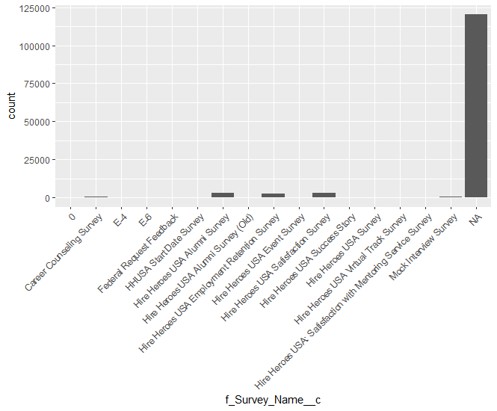
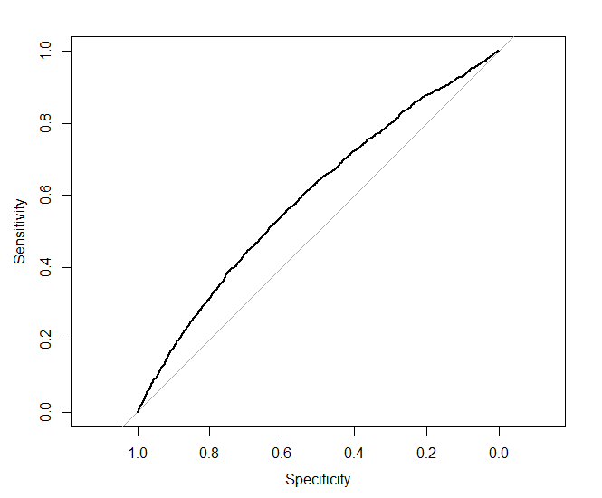
Q4. Client demographic and Survey relationship
Variables considered for this:
Dependent: Survey completed
Model Accuracy: 83.18%
Service Rank
Gender
Time in service
Spouse Status
Enrolled in school
Notes:
From our analysis we can conclude in a snippet that with respect to client demographic that client’s who are enrolled in school have the highest chance of filling out the survey and clients who are male can be more likely to complete a survey. We can also conclude that client’s who aren’t caregivers for their spouse are also more likely to complete surveys.
In detail-
We can interpret that,
Keeping everything else constant female clients are less likely to complete a survey with respect to male clients with the log odds of 0.09233.
Keeping everything else constant clients’ who are caregivers for their spouses are less likely to complete a survey with respect to clients’ who aren’t with the log odds of 0.978.
Keeping everything else constant clients enrolled in school are more likely to complete a survey with respect to clients not enrolled in school with the log odds of 0.0335. The enrollment of a client in school is very significant indicator for relationship between a client completing a survey or not.

Slide 13
Q5. Client Demographic and Confirmed hire
Variables considered for this:
Highest Education completed
Race
Gender
Enrolled in School
https://public.tableau.com/profile/nityanand.kore#!/vizhome/HHUSA-Emp-TypebyEducation-Gender/HHUSA-EmpTypeByGenderEducation

Slide 14
Closing Notes
Linear upward trend for client registration and Army people are more active on HHUSA.
No relationship found between time spent on client with their success in job
Email is most effective communication method
Probability of school enrolled male completing survey is better
High School diploma male client gets full time employment
Challenges:
Consolidation of all datasets
Missing and skewed data in many datasets

Slide 15
Q & A

Slide 16


